Slide 1
August 2016
Boomi Development Process - Basics

Slide 2
Agenda
Building process
Components
Connectors
Maps
Logic components
Deployment
Atoms
Environments
Licensing

Slide 3
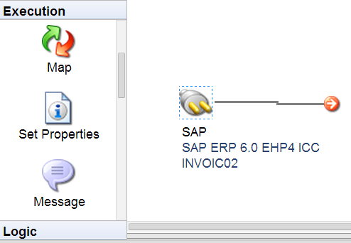


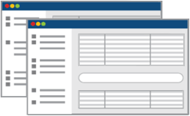
Process lifecycle
Build
Using the AtomSphere library of connectors and maps, visually design your integration processes and load them into a lightweight, dynamic run-time engine called an “Atom” for execution
Deploy
Deploy your Atoms to the AtomSphere for SaaS, PaaS, or cloud integration or safely behind your firewall for on-premises applications
Manage
Monitor and maintain the status of all your deployed Atoms, integration processes and trading partners, regardless of location, using a feature-rich web-based dashboard
1
2
3
Hosted
Download

Slide 4
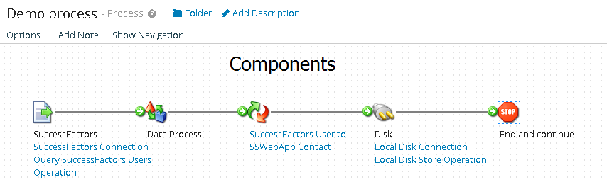
Components overview
Everything is a component
Component types
Connectors used for getting/sending data to external systems
Technology
Application
Execution allows to manipulate/change the data
Logic manages the process flow
Component usages are shortcuts

Slide 5
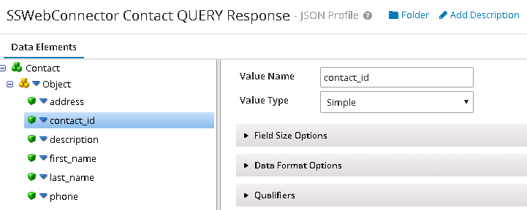
Connector overview
Connector consists of
Connection component contains the URLs/paths/credentials
Operation component defines the action
One or more Profiles
Profile defines the data format:
Database
Flat file
XML
JSON

Slide 6
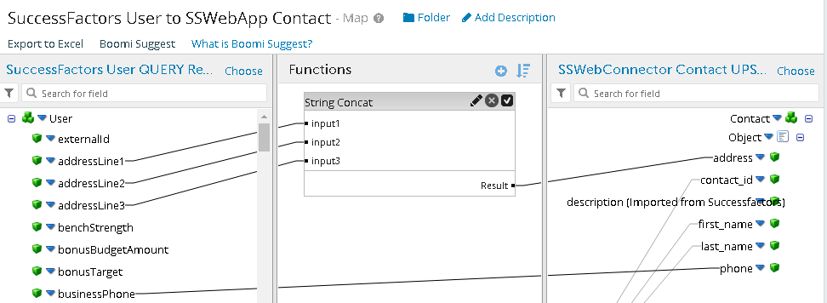
What is Map?
Map is a set of rules for transforming data from one Profile to another
Easy to create with simple Drag & Drop technique
Powerful functions engine
Boomi suggest

Slide 7
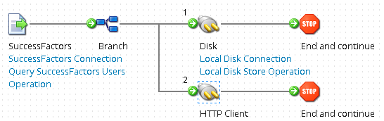
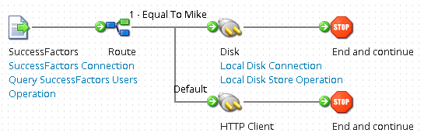
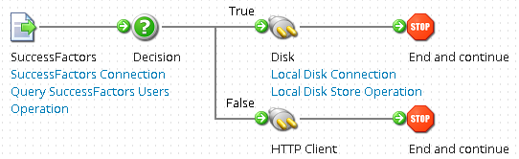
Managing the Process flow
Branches
Allow to process the same document several times
Routes
Allow to select one of several options with default
Decisions
Allow to choose one of two options

Slide 8
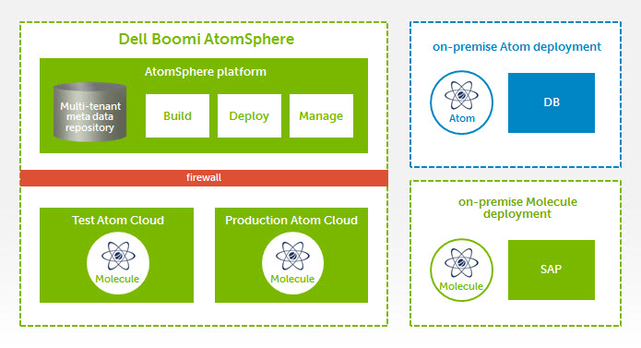
Process deployment
Atom
Molecule
Atom Cloud
Cloud/on premise systems
Single/multi node
Performance
Multitenancy

Slide 9
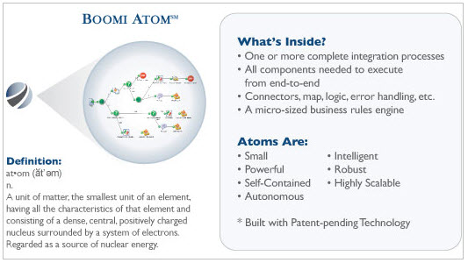
Atom

Slide 10
Private atom cloud
Private clouds allow partners to provide a hosted integration runtime engine for their customers
Single, shared engine that all customers will use
Clustered for high availability and scalability
Partner provides, monitors, and manages infrastructure to support runtime engine

Slide 11

Private atom cloud
Public Internet
Other Cloud Apps
Dell Boomi Platform
128-bit encryption
(metadata only)
Data
External firewall
Partner Infrastructure
Private Cloud Molecule
Multicast/
Unicast
Multicast/
Unicast
App Server 1
w/ Node 1
App Server 2
w/ Node 2
App Server N
w/ Node N
NFS
NFS
NFS
Clustered NAS / SAN Shared Storage
Molecule config, data, history

Slide 12
Private atom cloud
Process execution
Extendable
Forked execution
SOA worker
Load balancing
Clustering
Heap size
Computer power
Nodes quantity

Slide 13
Deployment procedure
Create and configure environment
Attach Atom to environment
Create process
Deploy process
Configure scheduler

Slide 14
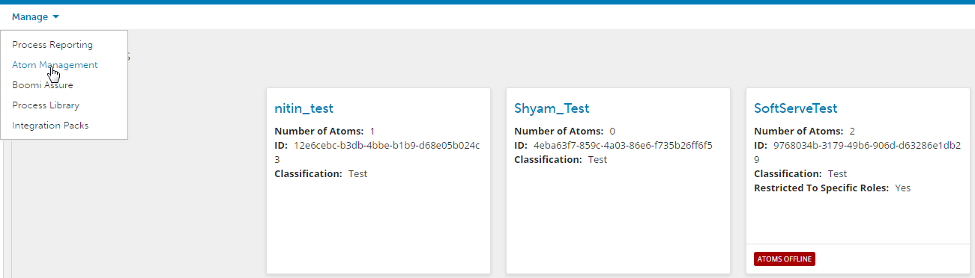
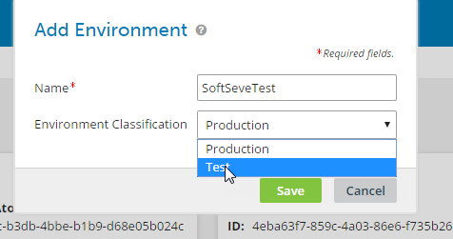
Environment creation
1. Go to Manage -> Atom management
2. Click “add environment”, choose Environment Classification

Slide 15
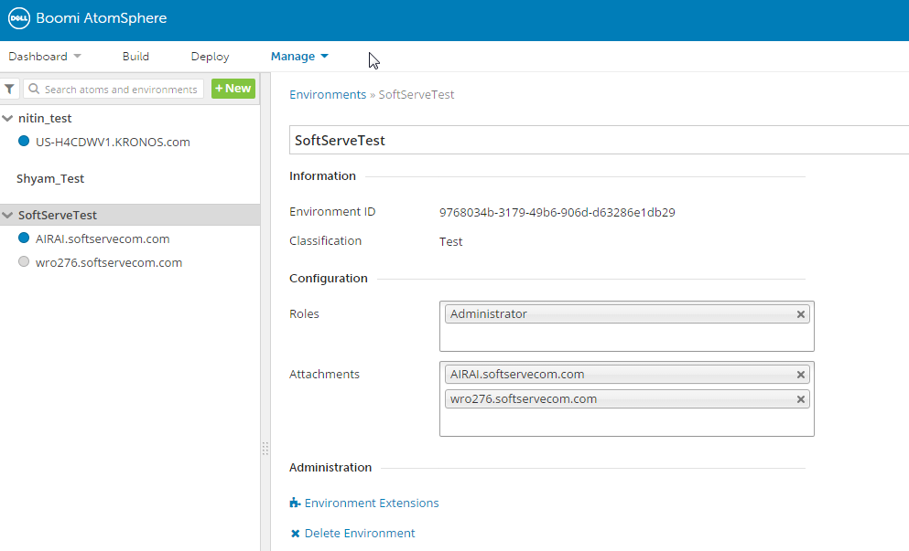
Environment creation
3. Configure Roles and attach Atoms

Slide 16
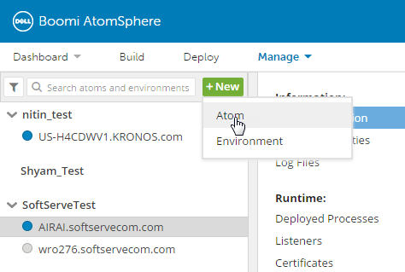
Atom creation and management
1. Go to “Manage” menu and create new atom
2. Choose Platform (Windows/Linux/Atom Cloud)

Slide 17
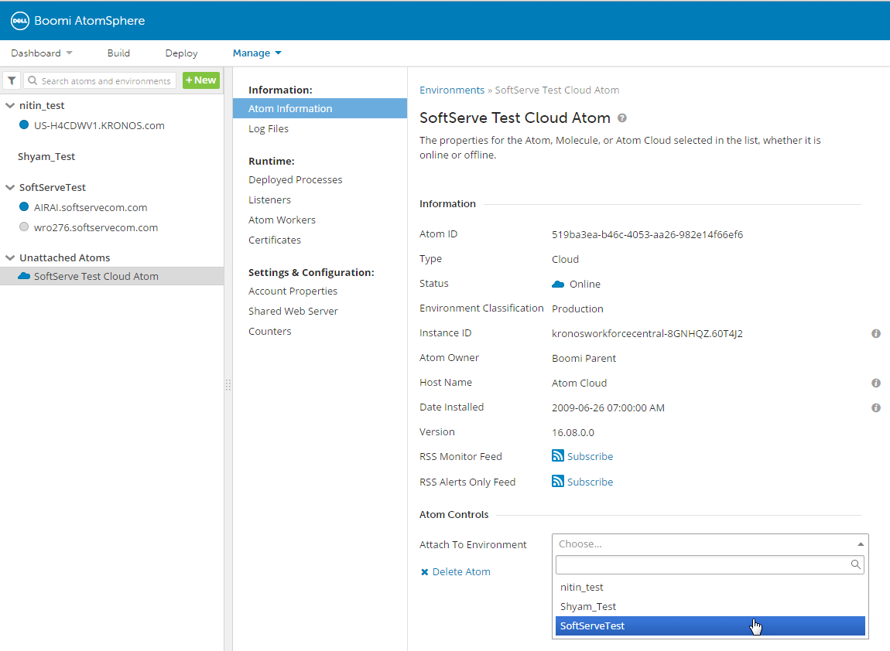
Atom creation and management
3. Attach Atom to Environment

Slide 18
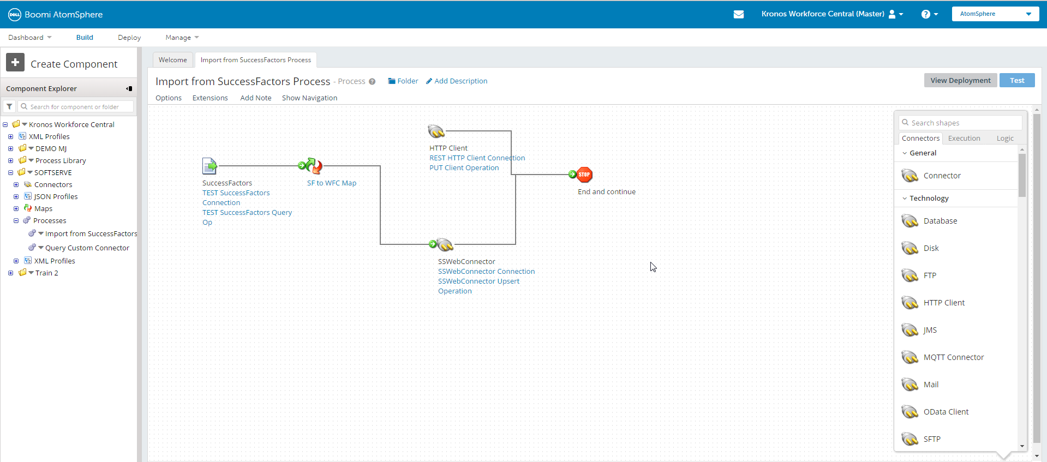
Create Process

Slide 19
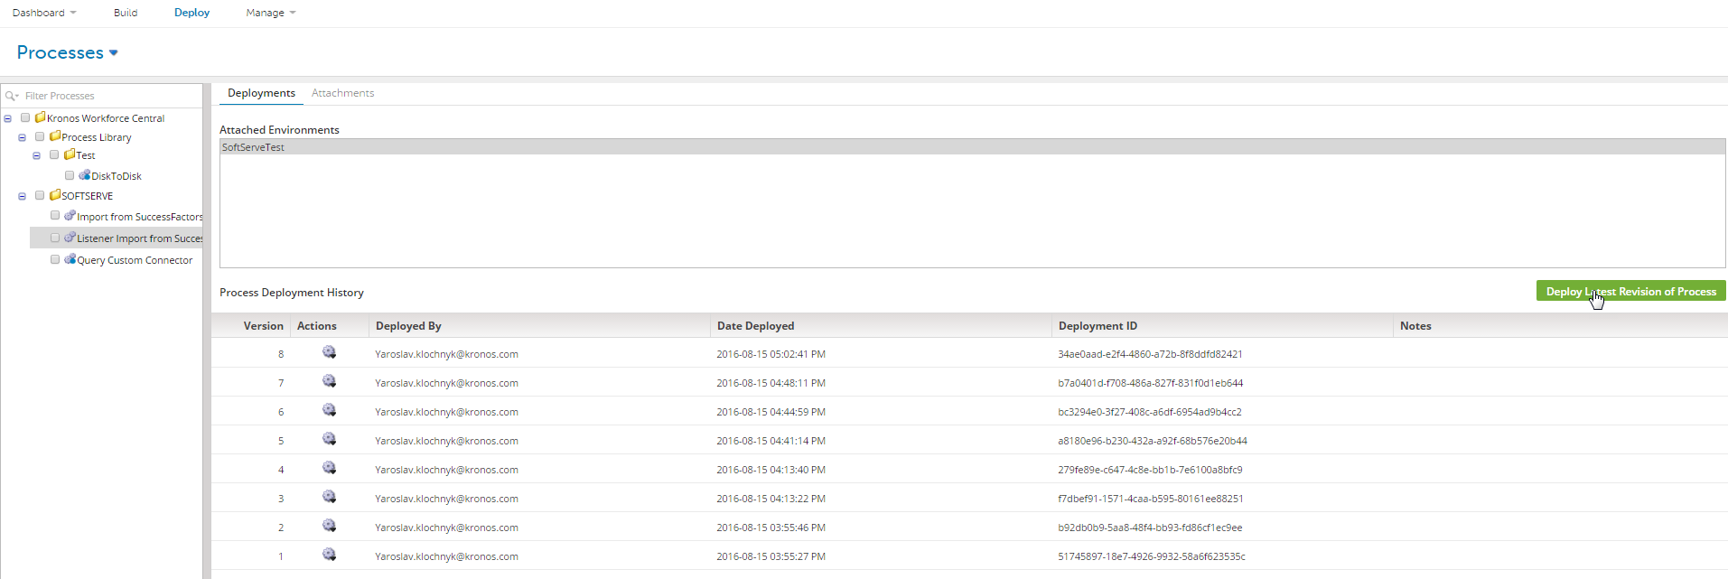
Deploy Process
Choose process, click “Deploy Latest Revision of Process”

Slide 20
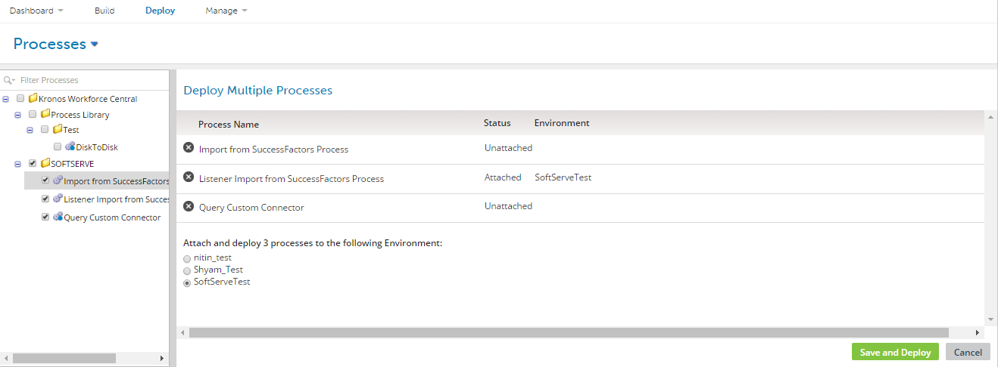
Multiple Processes Deployment
Choose processes, choose Environment, click “Save and Deploy”

Slide 21
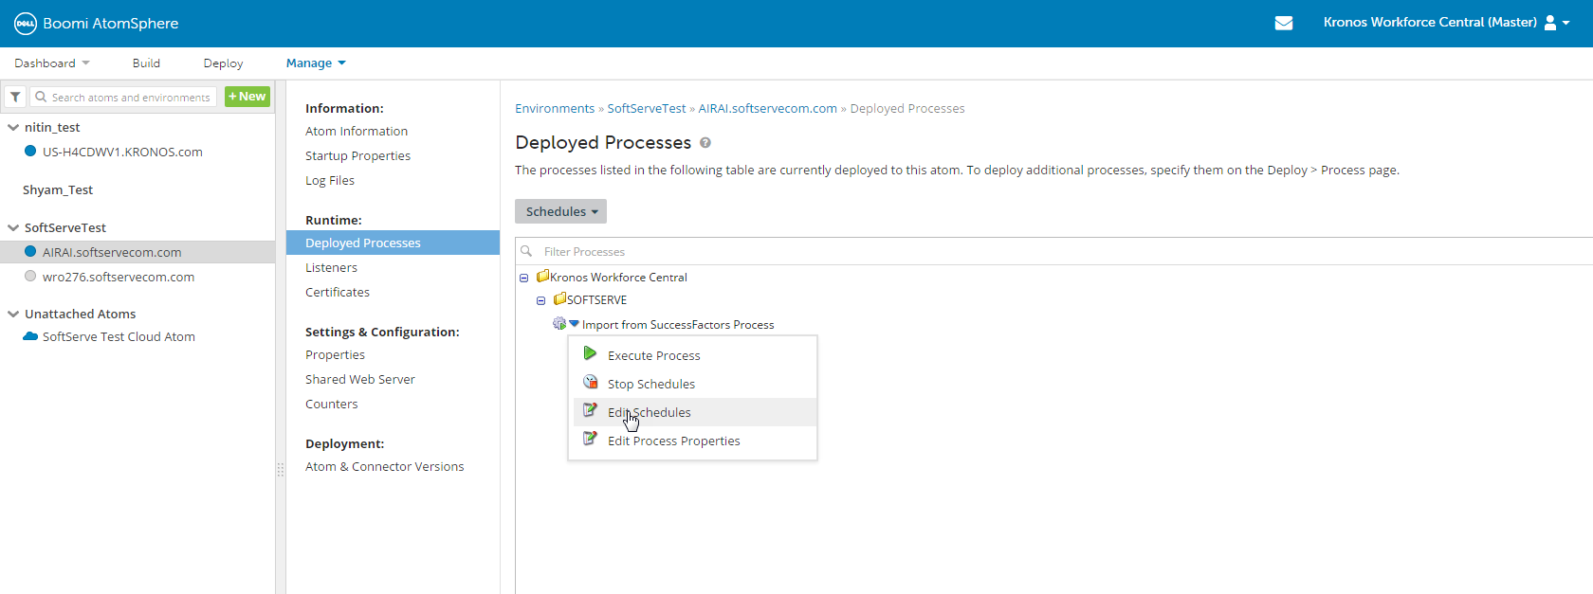
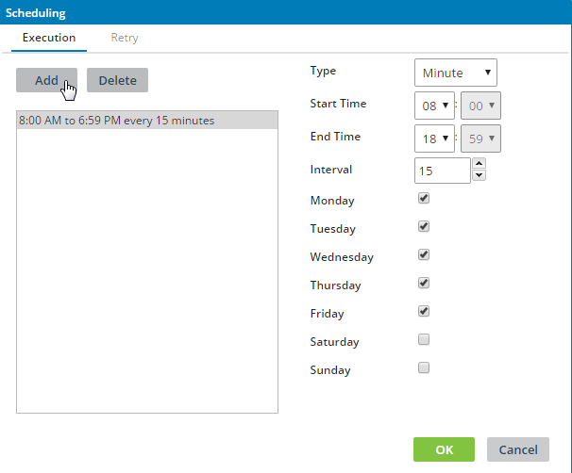
Configuring scheduler
Go to “Manage” -> “Atom Management”-> Choose deployed process -> Click on “Edit Schedules”

Slide 22
Licensing
Connections licensing:
Main restriction is how many connections your account is using in processes that are deployed to Atoms (unused processes should no longer be deployed)
Deploying a process to multiple Atoms will double the connection count
Only unique connections are taken into account
Different type of connections (standard, test, enterprise, ...)
Unlimited number of other components
Features licensing

Slide 23
Thank You

